Slide 1
AZ-203.1 Module 02: Implement batch jobs by using Azure Batch services
Subtitle or speaker name
Notes:
In this module, you will cover:
Azure Batch.
Running a batch job by using Azure CLI and Azure portal.
Running Batch jobs by using code.
Managing batch jobs by using Batch Service API.

Slide 2
Topics
Azure Batch
Run a batch job by using Azure CLI and Azure portal
Running batch jobs by using code
Manage batch jobs by using Batch Service API
Notes:
These are the topics that will be covered in this module.

Slide 3
Lesson 01: Azure Batch
Notes:
In this lesson, you will cover:
Azure Batch.
How Azure Batch works.
Azure Batch service resources.
Quotas and limits.

Slide 4
Azure Batch
High-performance computing (HPC) describes the aggregation of complex processes across many different machines, thereby maximizing the computing power of all the machines
Two types of workloads
Massively parallel
There needs to be a very large quantity of independent nodes processing simultaneously
Tightly-coupled
Multiple nodes need to talk often and in a very fast manner
Service that manages VMs for large-scale parallel and HPC applications
Autoscaling functionality
Job tracking/scheduling/management functionality
Notes:
Use Azure Batch to run large-scale parallel and high-performance computing (HPC) batch jobs efficiently in Azure. Azure Batch creates and manages a pool of compute nodes (virtual machines), installs the applications you want to run, and schedules jobs to run on the nodes. There is no cluster or job scheduler software to install, manage, or scale. Instead, you use Batch APIs and tools, command-line scripts, or the Azure portal to configure, manage, and monitor your jobs.
Developers can use Batch as a platform service to build SaaS applications or client apps where large-scale execution is required. For example, build a service with Batch to run a Monte Carlo risk simulation for a financial services company, or a service to process many images.

Slide 5





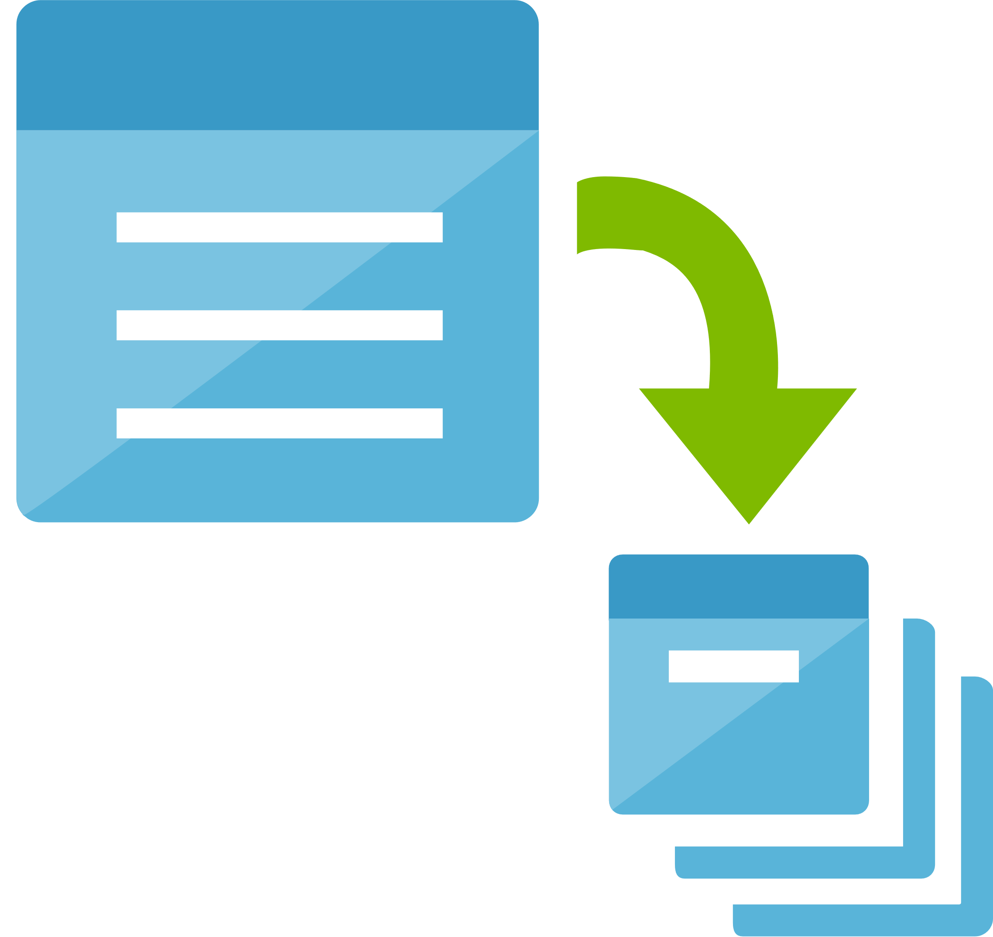





How Azure Batch works
Microsoft Azure
Upload input files and apps
Azure Storage
Download output files
Download input files and apps
Upload task output
Azure Batch
Job
Create pool, job, and tasks
Task
Task
Task
Monitor tasks
Pool
Application or service
Compute Node
Compute Node
Compute Node
Notes:
A common scenario for Batch involves scaling out intrinsically parallel work, such as the rendering of images for 3D scenes, on a pool of compute nodes. This pool of compute nodes can be your "render farm" that provides tens, hundreds, or even thousands of cores to your rendering job.

Slide 6
How Azure Batch works: breakdown
Upload input files and the applications to process those files to your Azure Storage account
Create a Batch pool of compute nodes in your Batch account, a job to run the workload on the pool, and tasks in the job
Download input files and the applications to Batch
Monitor task execution
Upload task output
Download output files
Notes:
The input files can be any data that your application processes, such as financial modeling data or video files to be transcoded. The application files can include scripts or applications that process the data, such as a media transcoder.
Pool nodes are the VMs that execute your tasks. Specify properties such as the number and size of the nodes, a Windows or Linux VM image, and an application to install when the nodes join the pool. Manage the cost and size of the pool by using low-priority VMs or automatically scaling the number of nodes as the workload changes. When you add tasks to a job, the Batch service automatically schedules the tasks for execution on the compute nodes in the pool. Each task uses the application that you uploaded to process the input files.
Before each task executes, it can download the input data that it is to process to the assigned compute node. If the application isn't already installed on the pool nodes, it can be downloaded here instead. When the downloads from Azure Storage complete, the task executes on the assigned node.
As the tasks run, query Batch to monitor the progress of the job and its tasks. Your client application or service communicates with the Batch service over HTTPS. Because you might be monitoring thousands of tasks running on thousands of compute nodes, be sure to query the Batch service efficiently.
As the tasks complete, they can upload their result data to Azure Storage. You can also retrieve files directly from the file system on a compute node.
When your monitoring detects that the tasks in your job have completed, your client application or service can download the output data for further processing.

Slide 7



Azure Batch example
Azure
Azure Batch
Upload input files
Pool
Input files
Job
Upload applications and dependencies
Storage
Applications and dependencies
VM
VM
VM
Admin
Tasks
Specify resources
VM
VM
VM
Queued, allocated, executed
Define and submit work, monitor results
VM
VM
VM
Application or service
Notes:
Upload input files and the applications to process those files to your Azure Storage account.
Create a Batch pool of compute nodes in your Batch account, a job to run the workload on the pool, and tasks in the job.
Download input files and the applications to Batch.
Monitor task execution.
Upload task output.
Download output files.

Slide 8
Azure Batch service resources
Account
Uniquely identified entity within the Batch service
Azure Storage account
Stores resource files and eventually output files
Compute node
A virtual machine dedicated to processing your application’s workload
Pool
Collection of compute nodes that runs the entire application
Notes:
Account
An Azure Batch account is a uniquely identified entity within the Batch service. All processing is associated with a Batch account.
You can create an Azure Batch account by using the Azure portal or programmatically, such as with the Batch Management .NET library. When creating the account, you can associate an Azure storage account for storing job-related input and output data or applications.
Azure Storage account
Most Batch solutions use Azure Storage for storing resource files and output files. For example, your Batch tasks (including standard tasks, start tasks, job preparation tasks, and job release tasks) typically specify resource files that reside in a storage account.
Compute node
A compute node is an Azure virtual machine (VM) or cloud service VM that is dedicated to processing a portion of your application's workload. The size of a node determines the number of CPU cores, memory capacity, and local file system size that is allocated to the node. You can create pools of Windows or Linux nodes by using Azure Cloud Services, images from the Azure Virtual Machines Marketplace, or custom images that you prepare. Examine the following Pool section for more information on these options.
Pool
A pool is a collection of nodes that your application runs on. The pool can be created manually by you, or automatically by the Batch service when you specify the work to be done. You can create and manage a pool that meets the resource requirements of your application. A pool can be used only by the Batch account in which it was created. A Batch account can have more than one pool.
Azure Batch pools build on top of the core Azure compute platform. They provide large-scale allocation, application installation, data distribution, health monitoring, and flexible adjustment of the number of compute nodes within a pool (scaling).

Slide 9
Quotas and limits
Resource | Default Limit | Maximum Limit
Batch accounts per region per subscription | 1 - 3 | 50
Dedicated cores per Batch account | 10 - 100 | N/A
Low-priority cores per Batch account | 10 - 100 | N/A
Active jobs and job schedules per Batch account | 100 - 300 | 1000
Pools per Batch account | 20 - 100 | 500
Notes:
As with other Azure services, there are limits on certain resources associated with the Batch service. Many of these limits are default quotas applied by Azure at the subscription or account level. This article discusses those defaults, and how you can request quota increases.
Keep these quotas in mind as you design and scale up your Batch workloads. For example, if your pool doesn't reach the target number of compute nodes you specified, you might have reached the core quota limit for your Batch account.
You can run multiple Batch workloads in a single Batch account, or distribute your workloads among Batch accounts that are in the same subscription, but in different Azure regions.

Slide 10
Lesson 02: Run a Batch job by using Azure CLI and Azure portal
Notes:
In this lesson, you will cover:
Running Batch jobs with Azure CLI.
Running Batch jobs with Azure portal.

Slide 11
Creating Batch account with Azure CLI
az batch account create \
--name mybatchaccount \
--storage-account mystorageaccount \
--resource-group myResourceGroup \
--location eastus2
az batch account login \
--name mybatchaccount \
--resource-group myResourceGroup \
--shared-key-auth
Notes:
Create a Batch account with the az batch account create command. You need an account to create compute resources (pools of compute nodes) and Batch jobs.
Note: You must have an existing storage account and resource group prior to create the Batch account.
To create and manage compute pools and jobs, you need to authenticate with Batch. Log in to the account with the az batch account login command. After you log in, your az batch commands use this account context.

Slide 12
Creating Batch pools and jobs with Azure CLI
az batch pool create \
--id mypool --vm-size Standard_A1_v2 \
--target-dedicated-nodes 2 \
--image canonical:ubuntuserver:16.04-LTS \
--node-agent-sku-id "batch.node.ubuntu 16.04"
az batch pool show --pool-id mypool \
--query "allocationState"
az batch job create \
--id myjob \
--pool-id mypool
Notes:
Create a pool of compute nodes
Now that you have a Batch account, create a sample pool of Linux compute nodes using the az batch pool create command.
This example creates a pool named mypool of 2 size Standard_A1_v2 nodes running Ubuntu 16.04 LTS. The suggested node size offers a good balance of performance versus cost for this example.
Batch creates the pool immediately, but it takes a few minutes to allocate and start the compute nodes. During this time, the pool is in the resizing state. To examine the status of the pool, run the az batch pool show command.
Now that you have a pool, create a job to run on it. A Batch job is a logical group for one or more tasks. A job includes settings common to the tasks, such as priority and the pool to run tasks on. Create a Batch job by using the az batch job create command.

Slide 13
Running Batch jobs with Azure CLI
for i in {1..4}
do
az batch task create \
--task-id mytask$i \
--job-id myjob \
--command-line "/bin/bash -c 'printenv | grep AZ_BATCH; sleep 90s'"
done
az batch task show \
--job-id myjob \
--task-id mytask1
Notes:
Create tasks
Now use the az batch task create command to create some tasks to run in the job. In this example, you create four identical tasks. Each task runs a command line to display the Batch environment variables on a compute node, and then waits 90 seconds. When you use Batch, this command line is where you specify your app or script. Batch provides a number of ways to deploy apps and scripts to compute nodes.
This Batch script creates 4 parallel tasks (mytask1 to mytask4).
After you create a task, Batch queues it to run on the pool. After a node is available to run it, the task runs.
Use the az batch task show command to view the status of the Batch tasks.

Slide 14
Viewing Batch job output with Azure CLI
az batch task file list \
--job-id myjob \
--task-id mytask1 \
--output table
az batch task file download \
--job-id myjob \
--task-id mytask1 \
--file-path stdout.txt \
--destination ./stdout.txt
Notes:
View task output
To list the files created by a task on a compute node, use the az batch task file list command.
To download one of the output files to a local directory, use the az batch task file download command.
You can view the contents of stdout.txt in a text editor. The contents show the Azure Batch environment variables that are set on the node. When you create your own Batch jobs, you can reference these environment variables in task command lines, and in the apps and scripts run by the command lines.

Slide 15
Demo: Running Batch jobs with Azure portal
Notes:
This revision of the course does not ship with demo instructions. For each demo, you will be given a list of specific tasks you should demonstrate to your students. The flow, content and structure of your demo is left to you to decide as an instructor.
In this demo, you should show students how to:
Create a Batch account.
Create a pool of compute nodes.
Create a job.
Create tasks.
View task output.

Slide 16
Lesson 03: Running Batch jobs by using code
Notes:
In this lesson, you will cover:
Batch Management Client Library.
Creating and deleting Batch accounts.
Retrieving and regenerating account keys.
Checking Azure and Batch account quotas.

Slide 17
Batch Management client library
.Net library used to automate Batch account:
Creation
Deletion
Key management
Quota discovery
You can use the library to:
Create and delete Batch accounts within any region
Retrieve and regenerate account keys programmatically
Check account quotas before starting jobs, creating pools, or adding compute nodes
Combine Batch with features of other Azure services
Notes:
You can lower maintenance overhead in your Azure Batch applications by using the Batch Management .NET library to automate Batch account creation, deletion, key management, and quota discovery.
Create and delete Batch accounts within any region. If, as an independent software vendor (ISV), for example, you provide a service for your clients in which each is assigned a separate Batch account for billing purposes, you can add account creation and deletion capabilities to your customer portal.
Retrieve and regenerate account keys programmatically for any of your Batch accounts. This can help you comply with security policies that enforce periodic rollover or expiration of account keys. When you have several Batch accounts in various Azure regions, automation of this rollover process increases your solution's efficiency.
Check account quotas and take the trial-and-error guesswork out of determining which Batch accounts have what limits. By checking your account quotas before starting jobs, creating pools, or adding compute nodes, you can proactively adjust where or when these compute resources are created. You can determine which accounts require quota increases before allocating additional resources in those accounts.
Combine features of other Azure services for a full-featured management experience—by using Batch Management .NET, Azure Active Directory, and the Azure Resource Manager together in the same application. By using these features and their APIs, you can provide a smooth authentication experience, the ability to create and delete resource groups, and the capabilities that are described above for an end-to-end management solution.

Slide 18
Create and delete Batch accounts
// Create a new Batch account
await batchManagementClient.Account.CreateAsync("MyResourceGroup",
"mynewaccount",
new BatchAccountCreateParameters() { Location = "West US" });
// Get the new account from the Batch service
AccountResource account = await batchManagementClient.Account.GetAsync(
"MyResourceGroup",
"mynewaccount");
// Delete the account
await batchManagementClient.Account.DeleteAsync("MyResourceGroup",
account.Name);
Notes:
One of the primary features of the Batch Management API is the ability to create and delete Batch accounts in an Azure region. To do so, use BatchManagementClient.Account.CreateAsync and DeleteAsync, or their synchronous counterparts.
The following code snippet creates an account, obtains the newly created account from the Batch service, and then deletes it. In this snippet and the others in this section of the course, batchManagementClient is a fully initialized instance of BatchManagementClient.
Applications that use the Batch Management .NET library and its BatchManagementClient class require service administrator or coadministrator access to the subscription that owns the Batch account to be managed.

Slide 19
Retrieve and regenerate account keys
// Get and print the primary and secondary keys
BatchAccountListKeyResult accountKeys =
await batchManagementClient.Account.ListKeysAsync("MyResourceGroup", "mybatchaccount");
Console.WriteLine("Primary key: {0}", accountKeys.Primary);
Console.WriteLine("Secondary key: {0}", accountKeys.Secondary);
// Regenerate the primary key
BatchAccountRegenerateKeyResponse newKeys =
await batchManagementClient.Account.RegenerateKeyAsync(
"MyResourceGroup", "mybatchaccount",
new BatchAccountRegenerateKeyParameters() {
KeyName = AccountKeyType.Primary
});
Notes:
Obtain primary and secondary account keys from any Batch account within your subscription by using ListKeysAsync. You can regenerate those keys by using RegenerateKeyAsync.
You can create a streamlined connection workflow for your management applications. First, obtain an account key for the Batch account that you wish to manage with ListKeysAsync. Then, use this key when initializing the Batch .NET library's BatchSharedKeyCredentials class, which is used when initializing BatchClient.

Slide 20
Checking Azure and Batch account quotas
// Get a collection of all Batch accounts within the subscription
BatchAccountListResponse listResponse =
await batchManagementClient.Account.ListAsync(new AccountListParameters());
IList<AccountResource> accounts = listResponse.Accounts;
Console.WriteLine("Total number of Batch accounts under subscription id {0}: {1}",
creds.SubscriptionId,
accounts.Count);
// Get a count of all accounts within the target region
string region = "westus";
int accountsInRegion = accounts.Count(o => o.Location == region);
Notes:
Before creating a Batch account in a region, you can check your Azure subscription to examine whether you are able to add an account in that region.
In the code snippet below, we first use BatchManagementClient.Account.ListAsync to get a collection of all Batch accounts that are within a subscription. After we've obtained this collection, we determine how many accounts are in the target region.

Slide 21
Checking Azure and Batch account quotas for regions
// Get the account quota for the specified region
SubscriptionQuotasGetResponse quotaResponse = await batchManagementClient.Subscriptions.GetSubscriptionQuotasAsync(region);
Console.WriteLine("Account quota for {0} region: {1}", region, quotaResponse.AccountQuota);
// Determine how many accounts can be created in the target region
Console.WriteLine("Accounts in {0}: {1}", region, accountsInRegion);
Console.WriteLine("You can create {0} accounts in the {1} region.", quotaResponse.AccountQuota - accountsInRegion, region);
Notes:
We use BatchManagementClient.Subscriptions to obtain the Batch account quota and determine how many accounts (if any) can be created in that region. In the snippet above, creds is an instance of TokenCloudCredentials.

Slide 22
Checking Azure and Batch account resource quotas
// First obtain the Batch account
BatchAccountGetResponse getResponse =
await batchManagementClient.Account.GetAsync("MyResourceGroup", "mybatchaccount");
AccountResource account = getResponse.Resource;
// Now print the compute resource quotas for the account
Console.WriteLine("Core quota: {0}", account.Properties.CoreQuota);
Console.WriteLine("Pool quota: {0}", account.Properties.PoolQuota);
Console.WriteLine("Active job and job schedule quota: {0}", account.Properties.ActiveJobAndJobScheduleQuota);
Notes:
Before increasing compute resources in your Batch solution, you can check to ensure that the resources you want to allocate won't exceed the account's quotas. In the code snippet below, we print the quota information for the Batch account named mybatchaccount. In your own application, you could use such information to determine whether the account can handle the additional resources to be created.
While there are default quotas for Azure subscriptions and services, many of these limits can be raised by issuing a request in the Azure portal.

Slide 23
Lesson 04: Manage batch jobs by using Batch Service API
Notes:
In this lesson, you will cover:
Authenticating requests.
Batch status and error codes.
Common parameters and headers.
Specifying conditional headers.
Batch service REST API versioning.

Slide 24
Authenticating requests
Every request made against the Batch service must be authenticated
The Batch service supports authentication via either:
Shared key
Azure Active Directory (Azure AD)
Notes:
Azure AD is Microsoft’s multi-tenant cloud-based directory and identity management service. The Batch service supports authentication with Azure AD.
Note: Authentication with Azure AD is required only if your Batch account is set up to allocate pools in a user subscription. The pool allocation option is available when you create a new Batch account. If your account is set up to allocate pools in a subscription managed by Batch, then using Azure AD for authentication is optional.
To use Azure AD with the Batch service, you'll need the following endpoints.
The Azure AD endpoint "common" endpoint is:
https://login.microsoftonline.com/common
The resource endpoint for the Batch service is:
https://batch.core.windows.net/

Slide 25
Authenticating requests
Authorization Header: Authorization="SharedKey <AccountName>:<Signature>"
StringToSign = VERB + "\n" +
Content-Encoding + "\n"
Content-Language + "\n"
Content-Length + "\n"
Content-MD5 + "\n"
Content-Type + "\n" +
Date + "\n" +
If-Modified-Since + "\n"
If-Match + "\n"
If-None-Match + "\n"
If-Unmodified-Since + "\n"
Range + "\n"
CanonicalizedHeaders +
CanonicalizedResource; \

Slide 26
Authenticating requests (continued)
GET\n\n\n\n\n\n\n\n\n\n\n\nocp-date:Tue, 29 Jul 2014 21:49:13 GMT\n /myaccount/jobs\napi-version:2014-01-01.1.0\ntimeout:20
GET\n /*HTTP Verb*/
\n /*Content-Encoding*/
\n /*Content-Language*/
\n /*Content-Length*/
\n /*Content-MD5*/
\n /*Content-Type*/
\n /*Date*/
\n /*If-Modified-Since */
\n /*If-Match */
\n /*If-None-Match */
\n /*If-Unmodified-Since*/
\n /* Range */
ocp-date:Tue, 29 Jul 2014 21:49:13 GMT\n /*CanonicalizedHeaders*/
/myaccount/jobs\napi-version:2014-04-01.1.0\ntimeout:20 /*CanonicalizedResource*/
Authorization: SharedKey myaccount:ctzMq410TV3wS7upTBcunJTDLEJwMAZuFPfr0mrrA08=
Notes:
The following example shows a signature string for a request to list the jobs in an account with a timeout of 20 seconds. When a header value does not exist, only the new line character is specified.
Breaking this down line-by-line shows each portion of the same string.
Next, encode this string by using the HMAC-SHA256 algorithm over the UTF-8-encoded signature string, construct the Authorization header, and add the header to the request. This example shows the Authorization header for the same operation:

Slide 27
Batch status and error codes
REST API operations for the Batch service return standard HTTP status codes, as defined in the HTTP/1.1 Status Code Definitions
{
"code": "InvalidQueryParameterValue",
"message": { "lang": "en-us", "value": "Value for one of the query parameters specified in the request URI is invalid" },
"values": [{
"key": "QueryParameterName",
"value": "state"
}, {
"key": "QueryParameterValue",
"value": "deleted"
}, {
"key": "Reason",
"value": "invalid state"
}]}
Notes:
API operations might also return additional error information to provide the developer with more information about the error.
For example, the example error response indicates that a query parameter specified on the request URI was invalid, and provides additional information about the invalid parameter’s name and value and the reason for the error.

Slide 28
Job/task scheduling error codes
If the Batch service encounters an error, the task is marked as completed and an error message is stored in the output of the task
There are two categories of errors:
UserError – Errors in the task specification provided by the user
ServerError – Errors encountered by the Batch service that prevent it from scheduling the task
Notes:
If the Batch service encounters an error when starting a task on a node, it marks the task as completed. The error information is returned within a failureInfo element in the response body of the list the files associated with a task and Get information about a task’s APIs.
Similarly, if the Batch service encounters an error while starting the job, it marks the job as completed. This scheduling error information is returned within a schedulingError element in the response body of Get information about a job in Batch APIs.

Slide 29
Job/task scheduling error codes (continued)
{
"preProcessingError": {
"category": "UserError",
"code": "BlobNotFound",
"message": "The specified blob does not exist.",
"values": {
"name": "FilePath",
"value": "myfile.txt"
}
}
}
Notes:
This is a sample pre-processing error returned by the Batch service.

Slide 30
Common parameters and headers
The following headers are common to all Batch resource operations:
$select
Project a subset of properties for the resource
$skiptoken
Specified if a partial result is returned in a previous operation call
Commonly used for pagination scenarios
$maxresults
Number of items to return in a response
Limits exist for each resource type
Authorization
String that contains the authentication scheme, account name, and authentication signature
Resource | Maximum Quantity
Certificates | 100
Pools | 1000
Nodes | 1000
Job Schedules | 1000
Jobs | 1000
Tasks | 1000
Notes:
Specify the optional $select value as a list of properties to return for a resource.
Specify the optional $skiptoken value in the URI if a partial result is returned in a previous operation call. If the response contains an odata.nextLink element, the value of the odata.nextLink element includes a $skiptoken parameter with a value that specifies the starting point in the collection of entities for the next GET operation. The $skiptoken parameter must only be used on the URI contained in the value of the odata.nextLink element.
Specify the optional maxresults value in the URI to define the number of items to return in a response. The maximum number of items varies based on the resource:
A maximum of 100 certificates can be returned.
A maximum of 1000 pools can be returned.
A maximum of 1000 nodes can be returned.
A maximum of 1000 job schedules can be returned.
A maximum of 1000 jobs can be returned.
A maximum of 1000 tasks can be returned.
Set the Authorization header to a string that contains the authentication scheme, the account name, and the authentication signature.

Slide 31
Specifying conditional headers
Batch service follows the HTTP/1.1 protocol that allows you to specify conditional headers
If-Match
If-None-Match
If-Modified-Since
If-Unmodified-Since
READ OPERATIONS
WRITE OPERATIONS
Conditional header | Response code if condition fails
If-Match | Precondition Failed (412)
If-None-Match | Not Modified (304)
If-Modified-Since | Not Modified (304)
If-Unmodified-Since | Precondition Failed (412)
Conditional header | Response code if condition fails
If-Match | Precondition Failed (412)
If-None-Match | Precondition Failed (412)
If-Modified-Since | Precondition Failed (412)
If-Unmodified-Since | Precondition Failed (412)
Notes:
The Batch service follows the HTTP/1.1 protocol specification for conditional headers, and uses the below rules to process requests specifying conditional headers:
If a request specifies both the If-None-Match and If-Modified-Since headers, the request is evaluated based on the criteria specified in If-None-Match.
If a request specifies both the If-Match and If-Unmodified-Since headers, the request is evaluated based on the criteria specified in If-Match.
With the exception of the two combinations of conditional headers listed above, a request may specify only a single conditional header. Specifying more than one conditional header results in status code 400 (Bad Request).

Slide 32
Batch service REST API versioning
The service is constantly evolving, with multiple versions being released over time
To “lock down” your REST API request to a specific version, use the api-version query parameter
Notes:
Operations provided by the Batch service REST API may have multiple versions for backward compatibility as the API evolves over time. You must specify which version of an operation you wish to use when it is called by providing the version with your REST call. If your application calls an older version of an operation, you can choose to continue calling the older version, or you can modify your code to call a newer version. If the version is not specified or an incorrect version is specified, then an error is returned.
To specify which version of an operation to use, set the api-version query parameter. The version is of the format Group.Major.Minor where Group is in the format ‘YYYY-MM-DD’ and Major is an integer and Minor is an integer.

Slide 33
Review
Azure Batch
Run a Batch job by using Azure CLI and Azure portal
Running Batch jobs by using code
Manage batch jobs by using Batch Service API
Notes:
These are the topics that we discussed in this module.

